Slide 1
FACE REPLACEMENT SYSTEM
Rajan Prasad Upadhyay (065/BCT/530)
Mubin Shrestha (065/BCT/518)
Robik Shrestha (065/BCT/534)
Ram Sharan Shrestha (065/BCT/531)

Slide 2
Face Replacement System is a system which replaces human faces in still images.
INTRODUCTION

Slide 3
OBJECTIVES
To implement skin color thresholding, snake algorithm and edge detection for face extraction
To implement warping, region growing, shifting, color consistency and blending for face replacement
To develop a face replacement application based on above algorithms

Slide 4
APPLICATIONS
Entertainment Industries
Facebook and iPhone apps
Photo Montage
Face Deidentification

Slide 5
SYSTEM BLOCK DIAGRAM
Load
Source and Target Images
Provide Feature Points
Extract Face Regions
Adjust Color Consistency
Apply Blending at Boundary
Find the Best Point for Replacement
Warp Source Image

Slide 6
FACE EXTRACTION

Slide 7
FACE EXTRACTION
Two major steps
Rough face region extraction
Post processing to enhance the region

Slide 8
FACE REGION EXTRACTION
There are 3 alternatives:
Skin Color Thresholding
Snake Algorithm
Edge Detection

Slide 9
1. SKIN COLOR THRESHOLDING
Face region is extracted by selecting only skin colored pixels in the image.
Thresholding is applied in Y-Cb-Cr color space.

Slide 10
SKIN COLOR THRESHOLDING
IMAGE
(RGB COLOR SPACE)
IMAGE
(YCbCr COLOR SPACE)
Y =50 to 240
Cb =-50 to -5
Cr = 0 to 50
RESULT

Slide 11


RESULT
Original Image
Result of Skin Region Detection

Slide 12
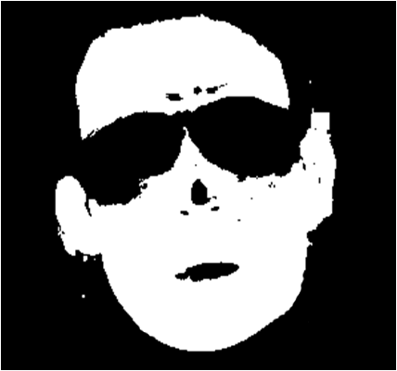
SKIN COLOR THRESHOLDING
Problem:
The output of the skin color detection contains
Noise and Hole.
Hole
Noise
Result obtained after applying Skin Color Thresholding

Slide 13
Solution For Holes: HOLE FILLING ALGORITHM

Slide 14

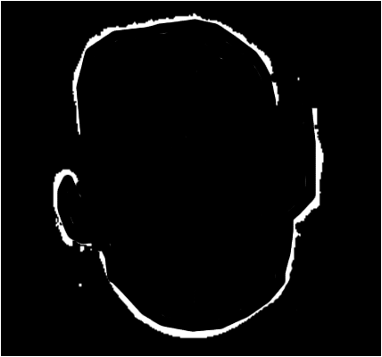
HOLE FILLING ALGORITHM
FILLING IN X-DIRECTION
FACE MASK
BOUNDARY

Slide 15

HOLE FILLING ALGORITHM
X-direction filled mask
Y-direction filled mask
Area contributed by Noise

Slide 16
HOLE FILLING ISSUES
Noises present in the mask may produce bad result.
Noise reduction should be done first.

Slide 17
Solution For Noise: PIXEL SHRINKING AND GROWING

Slide 18
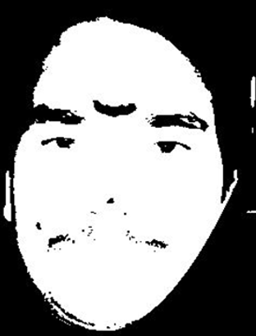
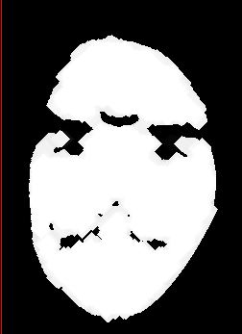
SHRINKING AND GROWING
Presence of Noise
Removal of Noise
Before Shrinking and Growing
After Shrinking and Growing

Slide 19
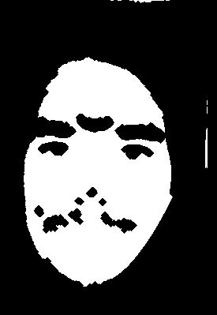
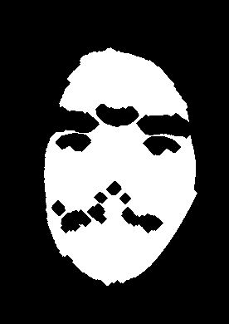
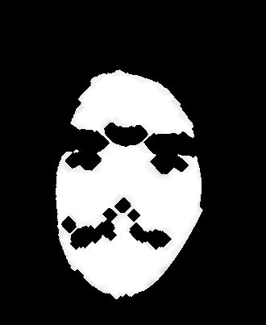
EXAMPLE OF SHRINKING
The figures show the results of the “shrinking” algorithm

Slide 20
GROWING
“Growing” algorithm restores the
original shape and size of the image.

Slide 21
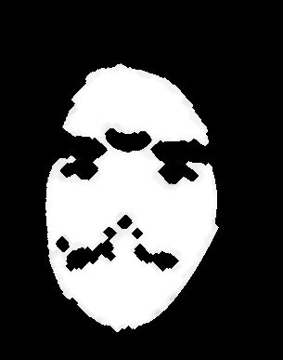
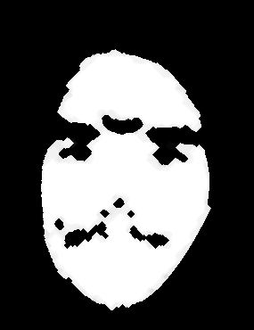
EXAMPLE OF GROWING
The figures show the results of the “growing” algorithm

Slide 22
2.EDGE BASED FACE EXTRACTION
CANNY EDGE DETECTION

Slide 23

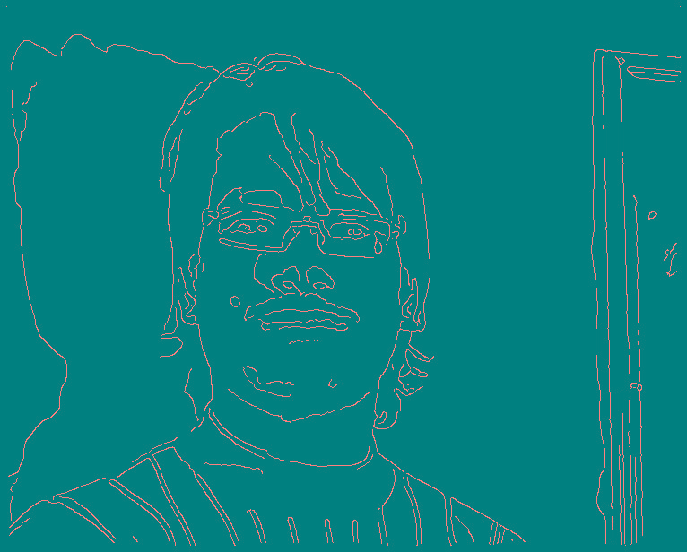
CANNY EDGE DETECTION
Input Image | Output Image (Low threshold = 1 High threshold = 4)

Slide 24
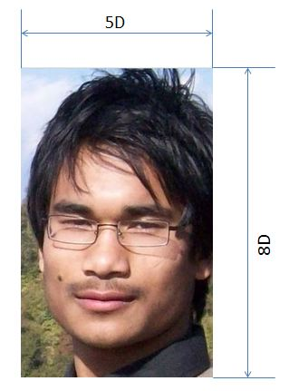
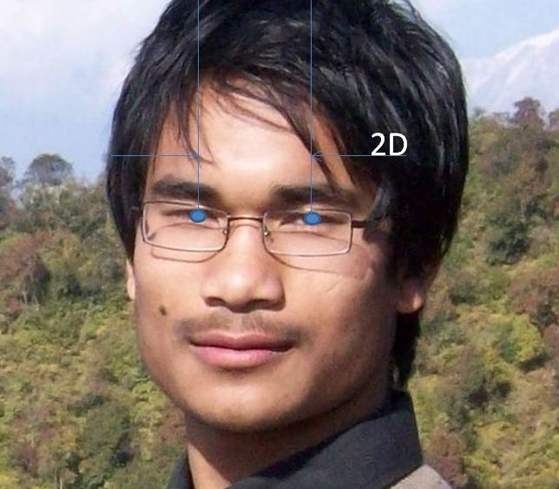
Separation between eyes
Rectangle around the face

Slide 25
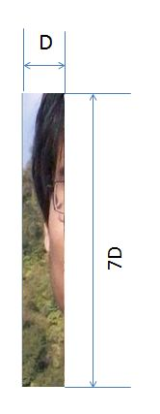
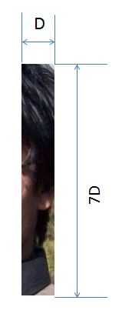
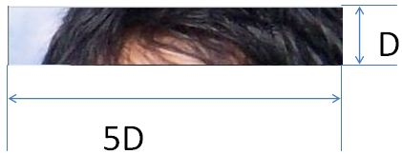
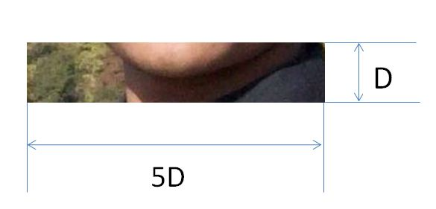

Slide 26

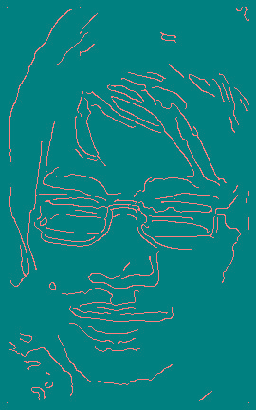



OUTPUT OF CANNY EDGE DETECTION

Slide 27

LONGEST EDGE DETECTION
Longest edges are considered to be parts of the face boundary.
Output after Canny Edge Detection
Longest edge

Slide 28

LONGEST EDGES
Edge map of longest edges of four region of face.

Slide 29
Genetic Algorithm
It was used to find the thresholds for Canny Edge Detection that give the longest edges.

Slide 30
Active Contour Model
The output of the edge map of the longest edges were supposed to be treated with the active contour model or Hough transform in order to find the continuity in the edges.

Slide 31
Problems
All the thresholds in the Canny Edge Detection provide the longest edges with the similar length.
This process consumes too much time

Slide 32
Solution
Adaptive active contour algorithm(Snake algorithm)
The result that was supposed to be obtained from above all methods of Canny Edge Detection, Genetic algorithm and active contour model was easily obtained by applying only Snake Algorithm

Slide 33
3. Adaptive Active Contour Model
(Snake Algorithm)

Slide 34
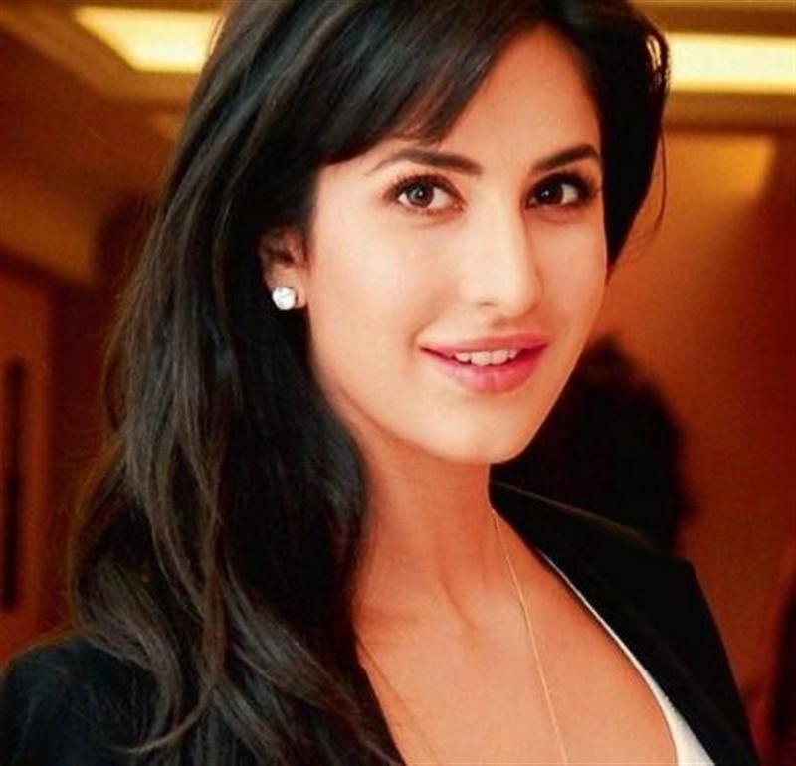
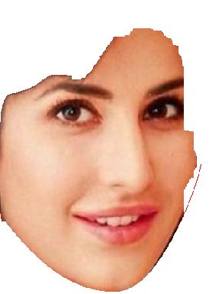
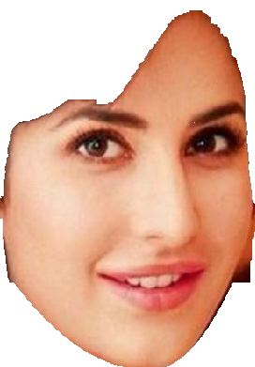
Skin color thresholding doesn’t give fine output for the faces with shadows.
Result of skin color thresholding
Result of snake algorithm
Original Image

Slide 35
The processing time of Snake Algorithm is lesser than the combined processing time of Canny Edge Detection, Active Contour Model and Genetic Algorithm.
Also the expected result from combined Canny Edge Detection, Genetic Algorithm and Active Contour Model was single obtained using Snake algorithm and even better.

Slide 36
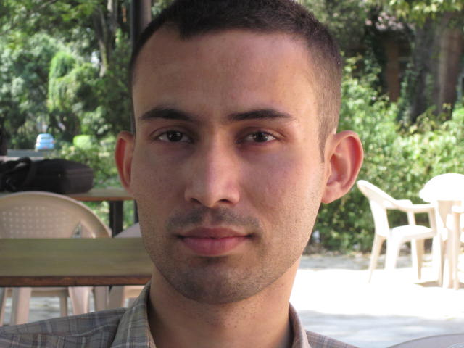
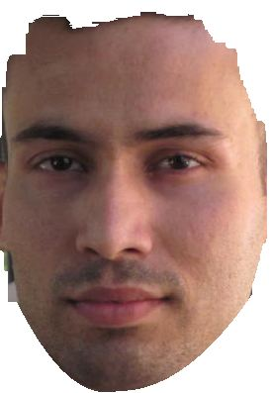

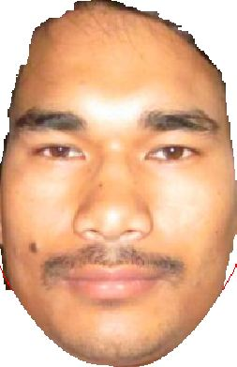
Outputs (Snake Algorithm)
T = 3 and I = 10
After applying Snake
T = 2 and I = 11
After applying Snake
Input Image
Output Image

Slide 37
Conclusion For Face Extraction
Use skin color thresholding when there is no shadow in face and face color can be separated from background.
Use snake algorithm when the face edges are clear

Slide 38
CHIN CURVE ESTIMATION
Chin curve can be estimated using feature points
It is used for separating face and neck region

Slide 39
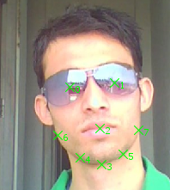
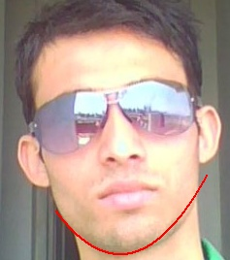
CHIN CURVE ESTIMATION
Original Image
Image with Chin curve

Slide 40
CHIN CURVE ESTIMATION
Before curve estimation
After curve estimation

Slide 41
3. HAIR AND BACKGROUND REMOVAL
Problem:
Hair and Background may have colors similar to that of the face.

Slide 42
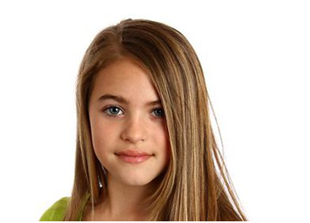
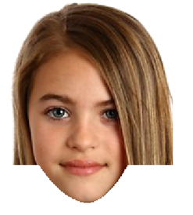
PROBLEM: HAIR IS EXTRACTED TOO
Hair is extracted too
Original Image
Result of Face Extraction

Slide 43
SOLUTION
Solution:
Extract Hair/ Background too.
Remove those regions from the result.

Slide 44
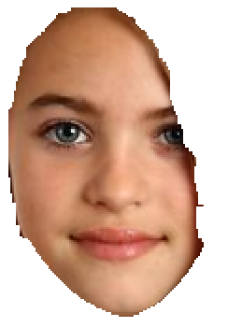
HAIR AND BACKGROUND REMOVAL
Before removing hair
After removing hair

Slide 45
BUT HOW?
Background and hair regions can be extracted
using:
SEED REGION GROWING ALGORITHM
It places similar (connected) pixels into same
region.

Slide 46
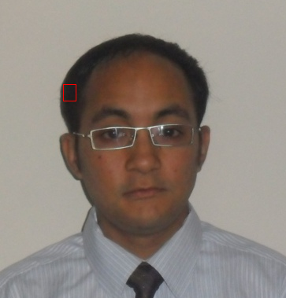
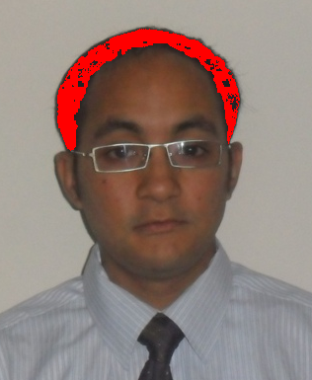
SEED REGION GROWING
Seeds
Specifying seed pixels
After applying “Seed Region Growing”
Notes:
Similarity Criteria,
Euclidean Distance
Mean +/- Coeff * Standard Deviation
Within Range

Slide 47
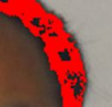
SEED REGION GROWING
Problem: The result contains “holes” inside the
region.
Hole
The image shows that the hair region has not been extracted properly.

Slide 48
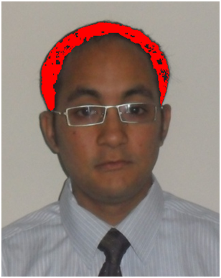
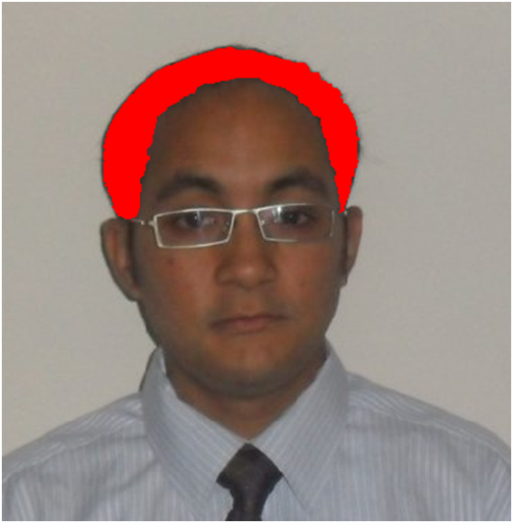
Solution: Fill up the holes
Before filling the holes
After filling the holes

Slide 49


IMAGE WARPING
Source and Target faces might have different
sizes and pose angles.
Source Image
Target Image with different size and pose

Slide 50
IMAGE WARPING
Therefore, the source image needs to be:
Shifted
Scaled
Rotated
This is image warping.
Notes:
1. The user needs to specify the feature points of the source and the target faces
2. Transformation matrix is found out by applying Least Square Method.
3. This matrix transforms source coordinates to warped image coordinates (which are almost equal to the target image coordinate)

Slide 51

EXAMPLE
Source
Target
After Warping
Here, the source face has been ROTATED ANTI-CLOCKWISE.
It has also been SCALED to a different size.

Slide 52
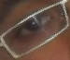
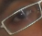
INTERPOLATION
The image thus obtained contains fuzziness. So the intensity levels should be interpolated.
Before Interpolation
After Interpolation
Notes:
4-connectivity Interpolation:
Weights are assigned to the neighbors
Weight = (1-distance)
Color value = Weighted sum of intensities of the neighbors

Slide 53
APPROPRIATE POSITION TO PASTE
The source face is pasted in such a way that region of overlap of the source and target face regions is the largest. The source face is shifted in search for such a position.
Notes:
Around target chin point
number of pixels (face to face –face to other than face)

Slide 54
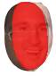

OVERLAP
LESS OVERLAP
MORE OVERLAP
NOT SO GOOD
MUCH BETTER

Slide 55
COLOR CONSISTENCY

Slide 56
HISTOGRAM MATCHING
It is a method of generating image that has a specified histogram
The specification of the histogram is given by the histogram of target image

Slide 57
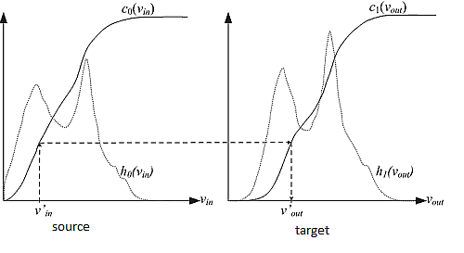
Frequency
Histogram
Normalized cumulative frequency
mapped
Intensity

Slide 58
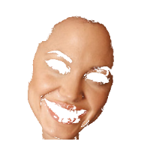
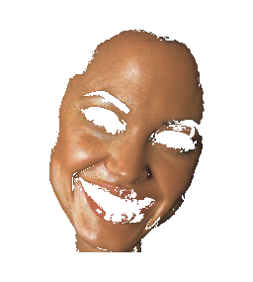
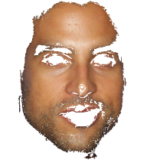
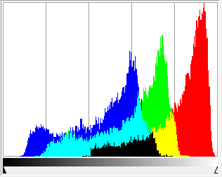
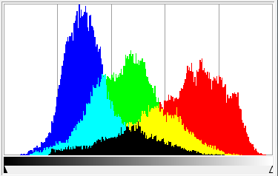
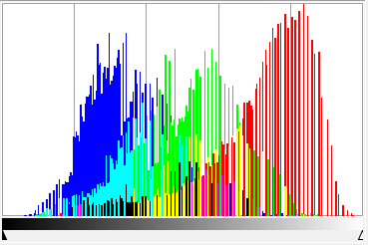
Result
Source image and its histogram
Target image and its histogram
Result image and its histogram

Slide 59
BLENDING
Two major steps
Alpha Blending
Intensity Interpolation

Slide 60
Alpha Blending
Used to smooth the sharp transition of regions in the boundary
Use iterative transparency variation

Slide 61
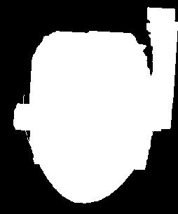
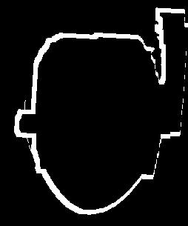
Process of alpha blending
Create a transparency gradient in the face boundary
Face Region
Face Boundary

Slide 62
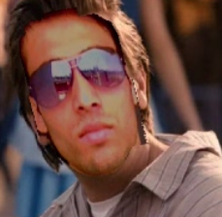
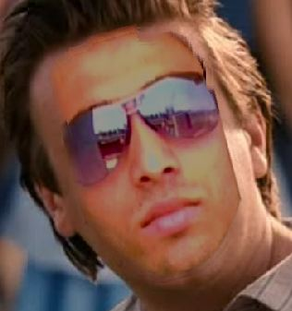
ALPHA BLENDING
Before alpha blending
After alpha blending

Slide 63
Intensity Interpolation
To reduce the region transition effect
Increase realistic look in the edge
Weighted Interpolation of Intensity through the boundary

Slide 64
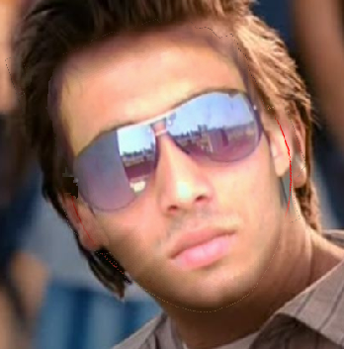
Change in result
Alpha blended image
Intensity gradient Image

Slide 65

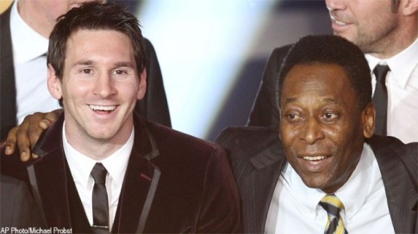
RESULTS OF FACE REPLACEMENT
SOURCE
TARGET

Slide 66
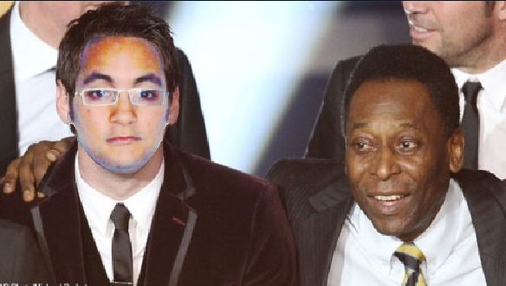
RESULT
RESULT

Slide 67



RESULT OF FACE REPLACEMENT
Source image
Target image
Result
`

Slide 68
FUTURE WORKS
The system can be extended for
1. profile (side) view.
2. transferring facial expressions.
3. notifying the users if the faces cannot be replaced accurately.
4. automatic feature points allocation

Slide 69

SCREENSHOTS OF APPLICATION

Slide 70

LOAD IMAGES

Slide 71

SPECIFY FEATURE POINTS OF SOURCE

Slide 72

SPECIFY SOURCE HAIR

Slide 73

SOURCE FACE EXTRACTION

Slide 74

SPECIFY TARGET FEATURE POINTS

Slide 75

SPECIFY TARGET HAIR

Slide 76

TARGET FACE EXTRACTION

Slide 77

FINAL RESULT

Slide 78
Thank You

Slide 79
Questions ?

Slide 80
BACKUP SLIDES

Slide 81


SKIN COLOR THRESHOLDING
YCbCr Color Space
2D Projection on CbCr
BLUE dots represent the reproducible color on a monitor
RED dots represent the skin color samples

Slide 82

OUTPUT OF SHRINKING AND GROWING
Original Image
Result of “shrinking and growing” algorithm
After hole filling

Slide 83
The face is divided into four regions:
Forehead
Left Face
Right Face
Bottom Face

